Slide 1
AI FOR SOUL OF EDEN
https://alan4chen.github.io/GPGPU2017_AI-for-Soul-of-Eden/
AI for Rayark's “Soul of Eden” GPU 2017 Final Project Team 1
Wei-Chung Liao B02902105@ntu.edu.tw
Chun-Wei Chen B02902063@ntu.edu.tw
Po-Yao Chen B02902071@ntu.edu.tw

Slide 2
Introduction to Soul of Eden
． A real-time strategy mobile card game.
． Use cards to destroy opposite’s castle.
． Two main groups and over 150 cards
(containing heroes, soldiers, buildings, and magic.)
． Adopt their strategies for different kinds of situations and win the battle.

Slide 3
Project Goals : Design an AI to play the game.
Defeat random AI (which only does a random play).
Defeat simple AI. (Simple AI: AI designed by statistics method.)
AI can reinforce by self-playing

Slide 4
Basic Game Rules
Simplified
Time Limit: 240 seconds, win/lose, otherwise, draw
Number of Cards each player can use in around: 30
Castle: 2800HP, Medium Attack power, Fast Attack speed
Tank: 621HP, Low attack damage, block attacks
Archer: 162HP, High attack damage, main attackers
Gunner: 162HP, Low attack damage, buff teammates
Choose a type of card to play every 4 seconds

Slide 5
Critical Problems & Solutions
Problem 1: Lack of real-time observation
-> Learn from acts of both sides
Problem 2: Range of Battle field
-> Divide the battle field into 50 ranges
Problem 3: Consider acts of both sides
-> Build a one-layer NN to map the 2 inputs into a vector

Slide 6
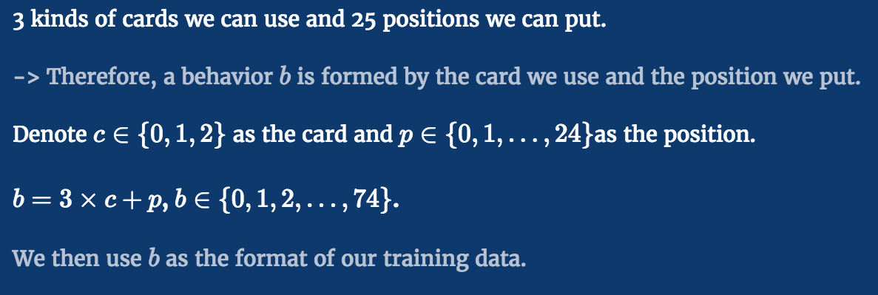
Data Preprocessing

Slide 7
Models
Random Model
Statistics Model
RNN Model ver. 1
RNN Model ver. 2

Slide 8
RNN Model ver. 1

Slide 9
RNN Model ver. 2

Slide 10
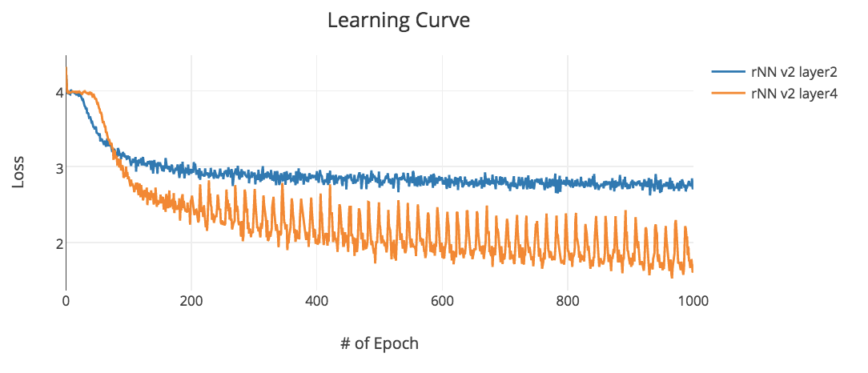
Results
Statistics Model > Random Model Play over 3,000 games and the statistics model have more than 80% winning rate
RNN Models vs Statistics Model Choose the best behaviors they think as the decision. All of the RNN models defeat the statistics model.
Two versions of RNN Model Winning rates are nearly equal.

Slide 11
Demo
(Confidential: No video recording!)

Slide 12
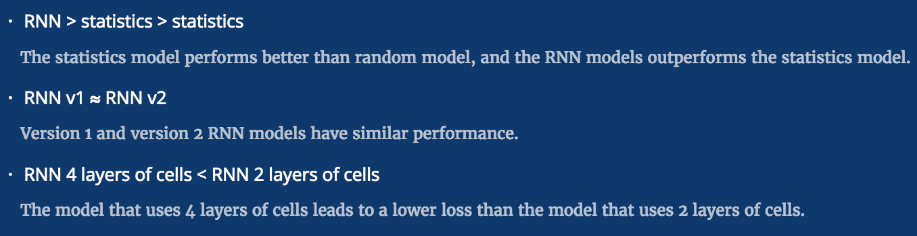
Conclusions

Slide 13
Future Work
1. High quality training data
Since we have some basic models now, We can use them to generate training data that has higher quality. We believe that the model could perform better if we use higher quality data.
2. Mapping (embedding) method in RNN models
In version 2 of RNN model, we can try to use more complicated mapping method to map the 2 inputs into a vector. Maybe the version2 does not work well since the mapping is too easy.

Slide 14
Thank You
Q&A

